Slide 1

Legal Practices
In a healthcare setting
Notes:
This PowerPoint is designed to review legal practices in a healthcare setting, and should include student questioning and discussion.

Slide 2
Objectives
5.21 Apply standards for HIPAA.
5.22 Describe advance directives.
5.23 Summarize the Patient’s Bill of Rights.
5.24 Understand informed consent.
5.25 Explain laws governing harassment, employment and scope of practice.

Slide 3


hipaa
Health Insurance Portability and Accountability Act
Federal protection for privacy of health information in all states.
Regulated by Department of Health and Human Services
The Health Insurance Portability and Accountability Act of 1996 (HIPAA) Privacy Rule
Notes:
Activate prior learning. At screen title, ask if any students know what HIPAA stands for.
Remind students that HIPAA is a federal (US government) law.
Do any students know what HHS stands for? It is the Department of Health and Human Services. Do they know who the currently serves as the Secretary of Health and Human Services?

Slide 4
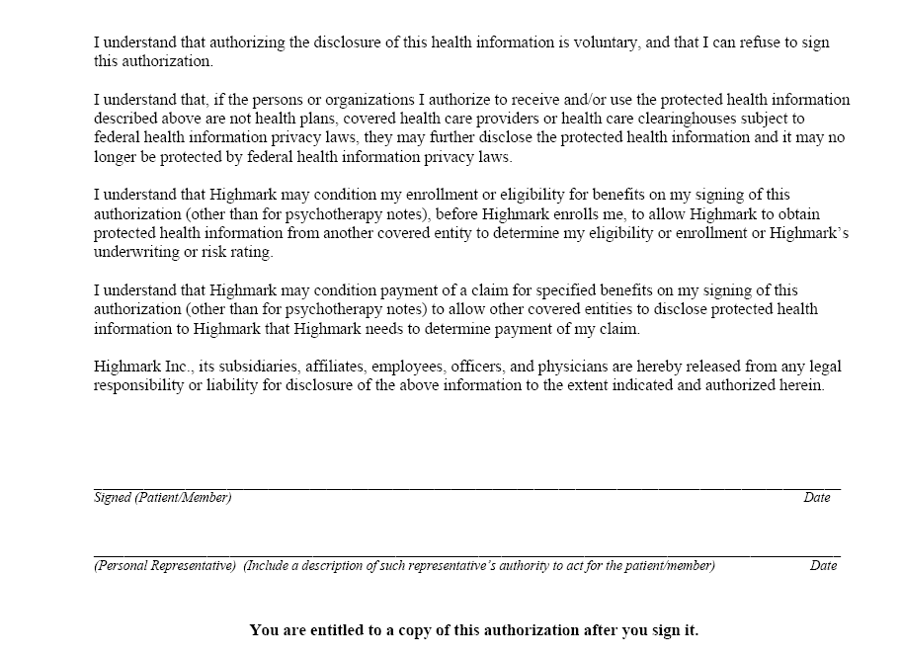
hipaa
Patients must sign HIPAA consent form for health care provider.
Notes:
Ask students if they have ever seen or signed a HIPAA consent form.
Ask if they had ever heard about HIPAA before learning about HIPAA in their health science class. (students examples can help connect learning.)

Slide 5
Patient’s rights
HIPAA requires that patients can get a copy of their records but does not prevent offices from charging a fee.
Patient’s can file a written request for correction of an errors on their medical records.

Slide 6
HIPAA
Only exception to confidentiality rules is information that must be reported by law to protect the safety and welfare of the public.
  Births and deaths
  Injuries caused by violence that require police involvement
  Communicable diseases
  Sexually transmitted diseases

Slide 7

Advance Directives
Also known as “legal directives”
A legal document
They allow individuals to state what medical treatment they want and do not want if they become incapacitated.
Two main directives:
  Living will
  Durable power of attorney (POA)
Notes:
Point out to students that the correct term is “advance” and not “advanced.”

Slide 8
LIVING WIll
Document that states measures that should not be taken to prolong life when the patient is terminal.
Must be signed when individual is competent and witnessed by two adults who would not benefit from the death.
Most states have laws that honor living wills.
Living wills often have a Do Not Resuscitate (DNR) request.
If so, a doctor may write a Do Not Resuscitate order.

Slide 9
Durable power of attorney
Also “Designation of Health Care Surrogate” or “Medical Power of Attorney”
Permits an individual (known as a principal) to appoint another person (known as an agent) to make healthcare decisions if the principal becomes unable to make decisions.
Usually given to spouse or adult children.
May be given to any qualified adult.
POA must be signed by the principal, the agent, and two adult witnesses.
Notes:
Help students understand the POA can be done in addition to a living will or instead of a living will.

Slide 10
Patient self determination act
Abbreviated PSDA
Federal law in 1990
Facilities receiving federal aid must:
  Inform patients of their right to make decisions concerning their medical care, including right-to-die.
  Provide assistance in preparing advance directives.
  Document advance directives in patient record.
  Provide written statements to implement the patient’s requests.
  Affirm no discrimination because of advance directives.
  Educate staff on legal issues regarding advance directives.
Notes:
After reading the bullet points, ask students to summarize the PSDA in their own words.

Slide 11
Patient’s Bill of Rights
Many different forms
  American Hospital Association – Patient’s Bill of Rights
  Mental Health Patient’s Bill of Rights
  Patient’s Bill of Rights for Medicare and Medicaid
  Resident’s Bill of Rights (OBRA)
  Managed Care Bill of Rights
  Complementary and Alternative Care Client Bill of Rights
  Etc.
Notes:
The purpose of this slide is to let students know that there are many organizations and professions who have written statements about the observance of patients’ rights.

Slide 12
Patients have a right to:
Considerate and respectful care.
Obtain complete, current information concerning diagnosis, treatment and prognosis.
Notes:
Ask students, which of these two standards do you think is most often compromised in a health care setting? The discussion will help students think about the rights by drawing from their own experiences.

Slide 13
Patients have a right to:
Receive information necessary to give informed consent prior to the start of any procedure.
Have advance directives for health care and/or refuse treatment to the extent permitted under law.
I refuse.
Notes:
Ask students - Do you think most patients are fully informed before giving consent to medical procedures?

Slide 14
Patients have a right to:
Privacy concerning a medical care program.
Confidential treatment of all communications and records.
Reasonable response to a request for services.
Notes:
Ask students – what law covers the confidentiality of all communication and records? They should ALL get this right.

Slide 15
Patients have a right to:
Obtain information regarding facility relationships to other healthcare and educational institutions.
Right to refuse to participate in research.
Reasonable continuity of care.
Notes:
Ask students – can you think of any example of when facility relationships would matter to a patient?

Slide 16
Patients have a right to:
Review medical records, examine bills, get explanations of care and charges.
Be informed of hospital rules and regulations, and available resources to resolve disputes or grievances.
You owe $9,999,999 for your office visit!
Notes:
Ask students – do you think patients ever negotiate their doctor bills or other healthcare charges?

Slide 17
Resident’s rights include:
Freedom from abuse and chemical/physical restraints.
Participate in family/resident groups and in social, religious and community activities.
Manage personal funds and use personal possessions.
To share a room with his/her spouse if both are residents.
Notes:
Point out to students that Patient’s Rights usually refers to hospitalized patients. Resident’s rights involve the rights of residents in long-term care or nursing homes.
Ask students – how are resident’s rights different from patient’s rights?

Slide 18
Informed Consent
Informed consent is permission granted voluntarily by a person who is of sound mind after the procedure and all risks have been explained in terms the person can understand.
Can be verbal, but for most procedures, should be in writing.
Person can withdraw consent at any time.
Procedures should not be performed if the patient does not give consent.
Consent Form
Notes:
Explain to students that as a health professional, they may be asked to witness a consent form.

Slide 19
Labor and employment
Americans with Disabilities Act
  Prevents employment discrimination against disabled workers who are qualified to perform the job with reasonable accommodations.
Civil Rights Act of 1964
  Prevents hiring discrimination on the basis of race, color, religion, sex, age or national origin.
Occupational Safety and Health Act (OSHA)
  Prevents unsafe working conditions.
Notes:
These are three labor laws that affect the employment of healthcare workers.

Slide 20
Sexual harassment
Unwelcome actions that are sexual in nature.
Victim and harasser may be man or woman, and may not be of the opposite sex.
Harasser can be a supervisor, coworker, or nonemployee.
Victim can be anyone affected by offensive conduct.
One of these days you’re going to stop pretending you don’t want to go out with me.
Notes:
Introduce this content by helping students understand the importance of this topic. Sometimes young people have a tendency to make light of the discussion of sexual harassment, but they really should take it seriously and learn the difference between actions that are permitted and not appropriate.

Slide 21
Sexual harassment
Victims should first speak directly to the harasser.
Clearly identify the unwelcome behavior and that it must stop.
If the harassment continues, follow the facility’s sexual harassment policy.
Doctor Jay, please do not ask me out again. I have a boyfriend and you are making me very uncomfortable.

Slide 22
Avoid sexual harassment
Avoid discussing sexual matters not related to the job.
Do NOT tell dirty jokes.
Avoid sharing intimate details of your personal life at work.
Do NOT joke about sexual matters.
Avoid touching coworkers and patients in suggestive ways.
Notes:
This might also be a good time to mention that healthcare workers should use care when forwarding funny e-mails, particularly from work e-mail.

Slide 23
grievance
A complaint about a circumstance considered to be unfair or potentially harmful.
Learn facility grievance policy.
Usually best to resolve workplace issues at the lowest level possible.
Start with your immediate supervisor.
Only file a grievance after working up the chain of command.
Grievance
Forms
Notes:
Explain the concept of chain of command. Ask students why they think it is important to follow the chain of command – why not just file a formal grievance every time they do not like something at work?

Slide 24
Scope of practice
What one is legally allowed to do in one’s profession.
You MUST understand and practice within the guidelines of your profession.
A supervisor should only ask you to perform activities within your scope of practice.
In most instances, you should refuse to perform skills outside your scope of practice.
Notes:
Many malpractice lawsuits are a result of violation of scope of practice.
Make sure students know that scope of practice varies from state to state in many different health professions. For example, in some states, Optometrists can perform eye surgery – in other states, only an ophthalmologist can perform eye surgery.

Slide 25

conclusion
Healthcare workers must know and follow the law in the practice of his/her profession – in order to safeguard the rights of the patient and the integrity of the profession.
Spend your career here . . . . not here.

